Slide 1
Civil Rights and Me
High School Lesson 2: Bullying, Cyberbullying and Online Safety
Notes:
Overview/Summary
Washoe County School District follows policies stating that students will receive annual training on identifying bullying in person and online, learn ways to report incidents at school and online and recognize forms of sexual and racial harassment. Every student is entitled to learn in an environment that is free of harassment, bullying, and discrimination. In Lesson 2, students will define bullying, identify bullying, recognize the harm that bullying causes and provide strategies on how to address bullying with positive outcomes. Students will work in small groups to develop an understanding of the components of bullying and how expressing empathy toward a victim of bullying can help the victim. Students will collaborate and value the differences that exist between them and their peers.
You know your students best. Adapt these activities to best engage your students.

Slide 2
Objectives
Students will be able to…
Define bullying behavior in person and online and provide examples
Identify strategies for online safety
Demonstrate an awareness of other people's perspectives and a respect for individual differences
Identify ways to develop empathy toward victims of bullying
Notes:
Teacher reads aloud to class OR ask students to popcorn read.

Slide 3
Working Agreements
Create and maintain a safe place for meaningful conversations.
Engage with each other and return to being present.
Speak your truth and accept these conversations MUST continue after today.
These conversations can be new and uncomfortable,
take care of yourself and each other.
Notes:
Ask students to popcorn read. Clarify as needed.
“Maintain brave and safe places for meaningful conversations” means that students should respect others’ perspectives and experiences with bullying. It is not a stance of right or wrong, but a stance of acceptance and an approach of learning. What can we learn from each other through these conversations? Also, conversations are going to be hard on certain topics. Students should have a clear expectation to embrace the discomfort and lean in on the conversation with the intent of learning from the experience and growing both socially and cognitively.
“Engage with each other and return to being present” means students should use accountable talk and value the differences in perspectives while interacting with one another. When prompted, students should engage in academic conversations with their peers. When prompted, students should stop their discussions and return to a whole class setting with their attention on the teacher.
“Speak your truth and accept these conversations MUST continue after today” means that when sharing your thoughts, speak to your knowledge and experiences. Don’t assume or speak for another group because you could misinterpret their words and experiences. The conversations that are held during this lesson aren’t done when this lesson is finished. Bullying is an ongoing concern that happens in many places and in many forms. To rid schools of bullying, the work against bullying is continuous and ongoing.
“Take care or yourself and each other” implies that respect is a crucial component of this lesson. Throughout the lesson students should demonstrate respect for others with their actions, words and thoughts. Students should embrace the challenges with the content, the diversity of the peers and learn that there is a common humanity that is affected by bullying. Whether a victim, a witness, or a bully, bullying impacts all members of incidents and society in different ways. Students should understand and learn to appreciate each other for their differences rather than isolate each other for having differences.

Slide 4
Notes:
Ask a student to read the quote aloud – or choral read as a class.
Allow students time to reflect. (15 seconds or so)
Have students discuss (partner, small group) the question: “How does this relate to bullying?”
Ask for students to share their responses with the class.

Slide 5
Think-Turn-Tell
What does bullying mean to you?
Define bullying in your own words.
Notes:
Read the question aloud to students.
Allow students time to reflect.
Have students discuss the question: “What does bullying mean to you?”
Ask for students to share their responses with the class.

Slide 6
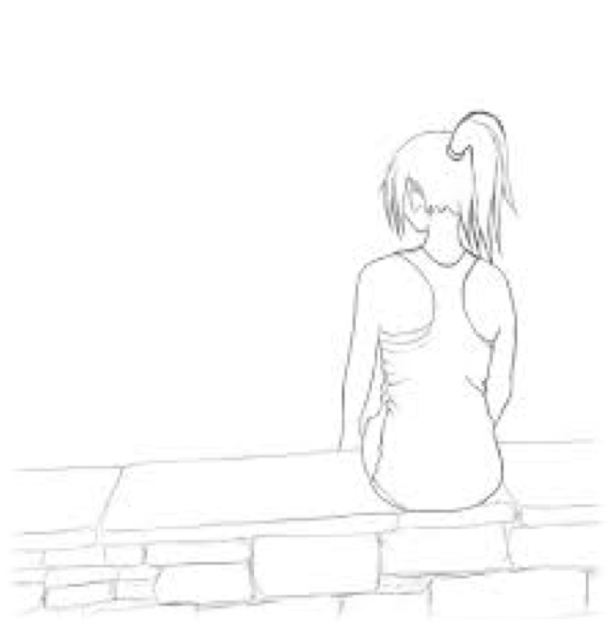
Key Vocabulary - Review
Bullying
Cyberbullying
Victim
Bystander
Upstander
Notes:
This should be a review of these terms – check for understanding.
Ask students to popcorn read.
Ask students to provide a definition for each term.
Clarify any misunderstandings with vocabulary.
Bullying: When someone does or says something intentionally hurtful, intimidating, or threatening and they keep repeating the behavior even after they are asked to stop​ --SafeVoice
Cyberbullying: the use of electronic communication to bully a person, typically by sending messages of an intimidating or threatening nature. -- Oxford Language
Victim: a person harmed or injured (physically or emotionally) after an event or action. –Oxford Language
Bystander: a person who is present at an event or incident but does not take part; a witness that doesn’t take action.
Upstander: someone who recognizes when something is wrong and acts to make it right; a witness that takes action.
Digital Learning Adaptation: Copy and paste definitions from slide notes into chat box to share with students.

Slide 7
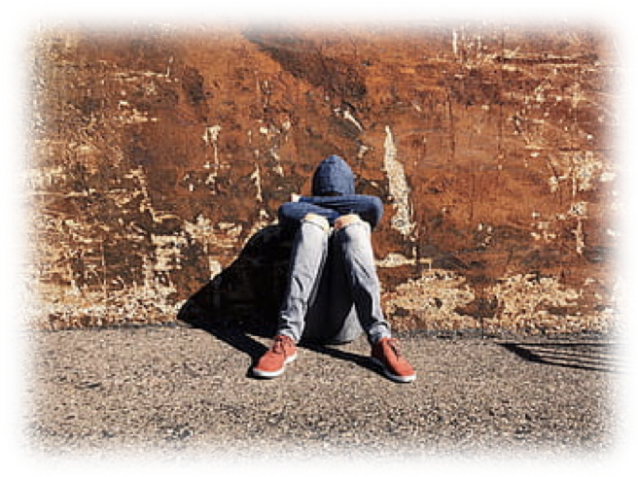
Bullying is…
Intentionally harmful actions or words
Those actions or words are…
Unwanted
Repeated
Create power imbalance
*Single SEVERE, harmful actions can be considered bullying.*
Notes:
Bullying is defined as…
“ When someone does or says something intentionally hurtful, intimidating, or threatening and they keep repeating the behavior even after they are asked to stop​” --SafeVoice
Emphasize to students…
Bullying is intentional (done on purpose).
Bullying is harmful (emotionally or physically)
Words/Actions that are considered bullying are…
Unwanted: the victim was underserving of the actions/words and doesn’t care for them
Repeated: the event is not isolated/one-time incident; it keeps happening multiple times daily or weekly
Creates a power imbalance: the victim is “helpless” and can’t control the outcome of the action or incident
Single, SEVERE acts can be considered bullying based on the student perception of the pervasive act.

Slide 8
Types of Bullying
Harassment/Threats
Discrimination
Intimidation
Exclusion/Social Isolation
Physical Aggression
Cyberbullying (online)
Retaliation
Notes:
These are the common types of bullying often seen in schools:
Harassment/Threats: Harassment is unwelcome conduct that is based on race, color, religion, sex (including pregnancy), national origin, age (40 or older), disability or genetic information. Harassment becomes unlawful when enduring the offensive conduct becomes a condition of continued employment; or the conduct is severe or pervasive enough to create a work environment that a reasonable person would consider intimidating, hostile, or abusive
Intimidation: intentional behavior that would cause an ordinary person to fear harm or injury
Exclusion/Social Isolation: Rejection is part of this and is usually an explicit verbal or explicit action that declares that the individual is not wanted as a member within a relationship or group
Physical Aggression: threat or use of bodily harm
Cyber: the use of electronic communication to bully a person, typically by sending messages of an intimidating or threatening nature
Retaliation: adverse action (e.g. payback, retribution, revenge) taken against an individual for engaging in legally protected activity such as making a complaint of harassment or participating in workplace or school site investigations

Slide 9
Is It Rude, Mean or Bullying??
Rude | Mean | Bullying
Thoughtlessly or accidentally saying or doing something that hurts someone else. | Purposefully saying or doing something to hurt someone once or maybe twice. | Intentionally harmful actions or words that are unwanted, repeated and create imbalance of power.
Notes:
Students will often confuse bullying with a mean or rude moment.
This slide clarifies the difference among the three.
Read to students OR have students popcorn read.
Rude actions are inconsiderate and often not thought out. The intent was not to harm the person listening. Example: Joke, horse play, pranks
Mean actions are done purposefully with the intent of inflicting harm. Mean actions aren’t repeated in contrast to bullying. Example: hurtful comment (when not repeated regularly)
Emphasize AGAIN the components of bullying

Slide 10
You decide
Rude, Mean or Bullying…
A senior repeatedly binder checks a freshman every time they pass each other in the hall.
Someone makes fun of another student’s shoes one day in Biology.
Jesse convinces others in her friend group to send Mia threatening messages on social media and stop talking to her at school for weeks.
Notes:
After reviewing the previous slide, ask students to identify in each instance whether this is a case of rude or mean behavior or an example of bullying.
Have students work in groups or with a partner to identify each case. Allow students to explain their reasoning as they share with the class.
Bullying - focus on the key word REPEATEDLY and EVERY TIME. Focus on the POWER DIFFERENTIAL because of age/grade
Rude or mean depends on the relationship between the students and the intention behind the statement – focus on how this ONE-TIME occurrence differs from bullying
Bullying & cyberbullying because Jesse and her friends threaten Mia ONLINE and ISOLATE her at school FOR WEEKS.
*Digital Learning Adaptation: Have students write their responses in that chat box*

Slide 11
Brain Break: Appreciation & Accolades
Thank you for…
I appreciate that you…
You deserve an award for…
Notes:
*This brain break intentionally divides the review material from the new content in this lesson.*
Appreciation & Accolades:
Help students refocus and practice building positive social norms by communicating appreciation for one another
Make sure each student has a shoulder partner (or create triads if needed)
Ask students to stand and stretch or breathe deeply for 30 seconds while they think about something they appreciate about their partner that they’d like to share with them. Students can use the sentence stems or give a sincere accolade in their own words – remind students that appreciation is much more meaningful when it focuses on personality or character, not looks, possessions or clothes.
Ask for a student volunteer and MODEL this by sharing an appreciation with them.
Give students time to share their appreciations and thank each other
Reflect: ask students to reflect on how it feels to share and receive appreciation
Digital Learning Adaptation – assign partners, paste the sentence stems from the slide into the chat and ask students to direct chat their partner.

Slide 12
Key Vocabulary - New
Social norms
Unwritten rules of behavior that are considered acceptable in a group
Change according to the environment, situation, and culture in which they are found
Change over time
Notes:
We anticipate this is a new term for many students.
Review the features of social norms – ask students to think about how social norms vary among the different groups to which they belong, (including in-person and virtual communities).

Slide 13
Social Awareness
Social norms can contribute to bullying,
OR
they can create a sense of community that fosters respectful behavior, empathy, acceptance and inclusion of ALL students so that bullying is less likely to happen.
Notes:
Clarify new terms
Empathy – the ability to understand and share the feelings of another
Acceptance – admitting someone to a group
Inclusion – the act of including within a group
In-person as well as online communities have norms. Often social-norms for online communities are very different to in-person communities.
Ask students to think about the ways the norms in their communities contribute to or help prevent bullying.

Slide 14
One Story: Michael, Kristopher & Antwan
Notes:
Click play to view the video
If you encounter technical problems:
YouTube search: High school football players’ gifts to freshman who was bullied GMA
Insert this URL in your web browser search bar: https://www.youtube.com/watch?v=_UNGgWtPT_I

Slide 15
1:1:1 Video Debrief
What types of bullying did Michael experience? | Were Kristopher and Antwan bystanders or upstanders? What actions did they take?
How did Kristopher and Antwan’s actions affect the social norms and sense of community at their school?
Notes:
*This is an engaging strategy which promotes equity of voice*
Ensure that every student has a partner (it can be the same partner from the brain break)
Explain: This activity is designed to allow equal talking time and active listening. Remember to speak your truth.”
Allow 30 seconds for students to read and process the questions – check for understanding
Round 1 - Partner A has one minute to speak, starting with the question of their choosing – Partner B listens carefully without commenting​. Listener - you may nod your head, smile or affirm what your partner says without speaking.
Reflection -
How did it feel to be Partner A? B? What stood out to you?​
Round 2 - Reverse the roles
Reflection -
How did it feel to be Partner A? B? What stood out to you?​
Round 3 – Both partners have a conversation for 1 minute – you may speak to the question in any order
Digital Learning Adaptation: Give students time to think about the questions and write a reflection for each. They can share directly with the teacher or whole group in the chat box. Debrief as a class.

Slide 16
Review: Working Agreements
Create and maintain a safe place for meaningful conversations.
Engage with each other and return to being present.
Speak your truth and accept these conversations MUST continue after today.
These conversations can be new and uncomfortable,
take care of yourself and each other.
Notes:
Revisit the working agreements to help ground students in these supports for the upcoming courageous conversations. Remember we want to support them in trusting themselves and trusting each other enough to speak openly and honestly.
Ask students: “which of these agreements feels the most important for you right now? How can you lean into that agreement?”

Slide 17
1:1:1 Personal Reflection
Why do you think that small gestures of kindness can make a big difference to the victims of bullying? | What are some actions that peers can take to be upstanders against bullying/cyberbullying?
Is bullying an accepted behavior in your school community? Is being an upstander an accepted behavior? | What steps can a (face-to-face or virtual) community take to change its social norms?
Notes:
*This engaging strategy allows students time to process and reflect before we close the lesson*
You may choose to keep students with the same partner, or choose a different partner for this last discussion.
Remind students that this activity is designed to allow equal talking time. ​(equity of voice)
Round 1 - Partner A has one minute to speak starting with the question of their choosing – Partner B listens carefully without commenting​. “Listener - you mad nod your head, smile or affirm what your partner says without speaking.”
Round 2 - Reverse the roles
Reflection
How did it feel to be Partner A? B? What stood out to you?​
Round 3 – Both partners have a conversation for 1 minute – you may speak to the question in any order.
Ask for volunteers to share with the whole class.
Digital Learning Adaptation: Give students time to think about the questions and write a reflection for each. They can share directly with the teacher or whole group in the chat box. Debrief as a class.

Slide 18
Reflective Closer
What is one takeaway from today?
What is one action you want to commit to as you move forward?
Notes:
Ask students to choose one of the two questions to answer on a half-sheet of paper or sticky note.
Take volunteers to share if time allows.
Digital Learning Adaptation: Students send their answers directly to the teacher via the chatbox (private or public)

